Slide 1
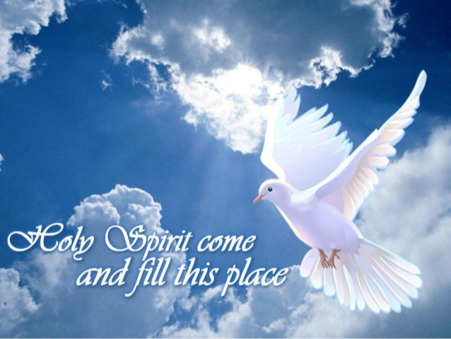
The mission and purpose of the Holy Spirit

Slide 2
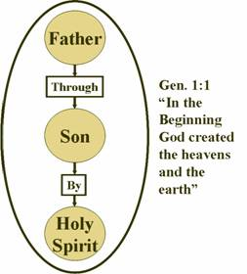
The Trinity of God
God has existed eternally as three (3) persons in one: The Father, The Son, and The Holy Spirit. Each person of the trinity is fully God,
THERE IS ONLY ONE GOD

Slide 3
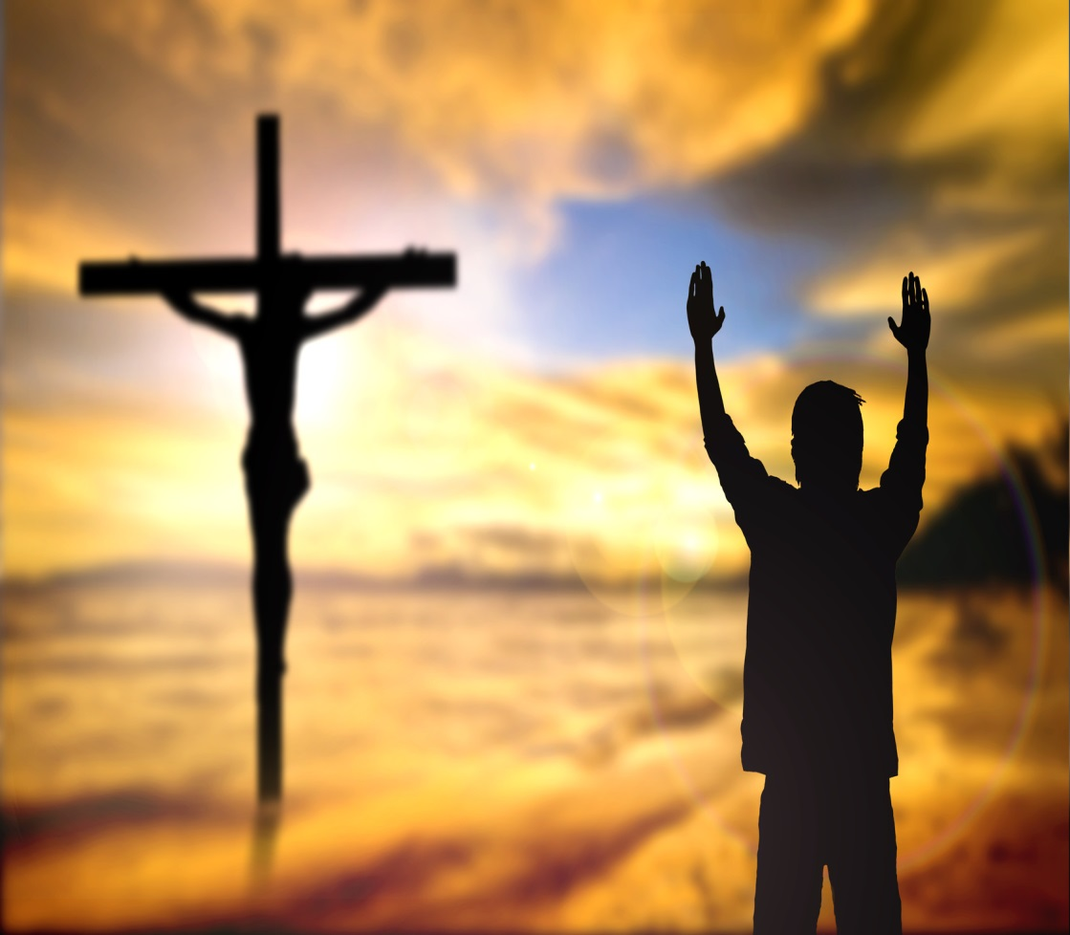
Holy Spirit Has always Been Here
Has always been part of the redemptive work of Salvation
Luke 1:35 “The Holy Spirit will come on you, and the power of the Most High will overshadow you. So the holy one to be born will be called^{[a]} the Son of God.

Slide 4
Jesus and Sending the Spirit of Truth
Regeneration of believers and give of life (Jon 20:22)
Empower Believers (Acts 1:4-5)

Slide 5
Receive The Holy Spirit and Fire
Matthew 3:11 - He will baptize you with the Holy Spirit and fire
Marc 1:8 - He will baptize you with the Holy Spirit.”
Luke 3:16 - He will baptize you with the Holy Spirit and fire
John 1:33 - And I myself did not know him, but the one who sent me to baptize with water told me, ‘The man on whom you see the Spirit come down and remain is the one who will baptize with the Holy Spirit.’

Slide 6
Mission and Purpose of the Holy Spirit
He will bring to the unbelieving world convincing conviction of sin, righteousness, and judgment to come ( John 16:7-11).
He will bring full knowledge of the saving truth in Jesus' teaching ( John 14:26 ; 15:26);
He will empower Christian believers for witness to the good news of salvation ( Luke 24:49 ; 46-48; Acts 1:8 ).

Slide 7
John 15: 26- 27
²⁶ “When the Advocate comes, whom I will send to you from the Father—the Spirit of truth who goes out from the Father—he will testify about me. ²⁷ And you also must testify, for you have been with me from the beginning.

Slide 8
Mission: What will de done
Purpose: How
Sent by Jesus
Comes from the Father
Testify and glorify Christ
Convicts the world of sin, because they do not believe in Jesus
Convicts the world of righteousness: Jesus goes to the Father, and see Him no more
Convicts the world of judgment because the ruler of this world is judged
He will guide us into all truth.
Remind us what Jesus said and did so we won’t stumble or be offended (e.g. Mt 5:29)
For He will not speak on His own authority, but whatever He hears He will speak.
For He will take of what is Jesus’ and declare it to us.
Not speaking on His own but everything He hears.
Will Glorify Jesus
He will take of what is Jesus’ and declare it to us.
He will let me known all things to come.
All things that the Father has are Mine. Therefore I said that He will take of Mine and declare it to you.^{[c]}
Notes:
If I had not come and spoken to them, they would have no sin, but now they have no excuse for their sin (John 15:22)

Slide 9
Convicts of Sin Through the Word of Truth
No one is seeking God, he found us first. “There is none righteous, no, not one; There is none who understands; There is none who seeks after God. They have all turned aside; They have together become unprofitable; There is none who does good, no, not one.” (Rom 3:10-12)
Convinced of Wrong: “Come now, and let us reason together,” Says the Lord, “Though your sins are like scarlet, They shall be as white as snow; Though they are red like crimson, They shall be as wool ( Isaiah 1:18)
Speak in ways we can understand: The teaching of your word gives light, so even the simple can understand (Psalm 119:130)
Speaks and lead us to all truth (john 16)

Slide 10
Convicts of Sin Through the Word of Truth
Washes, renew, regenerate us: not by works of righteousness which we have done, but according to His mercy He saved us, through the washing of regeneration and renewing of the Holy Spirit (Titus 3:5)
Bear witness in us that we are children of God: The Spirit Himself bears witness with our spirit that we are children of God (Romans 8:16)
Our guarantee and deposit of the future resurrection: “For we know that if our earthly house, this tent, is destroyed, we have a building from God, a house not made with hands, eternal in the heavens… Now He who has prepared us for this very thing is God, who also has given us the Spirit as a guarantee. So we are always confident, knowing that while we are at home in the body we are absent from the Lord.” (2 Cor 5:1-5)

Slide 11
Convicts of Sin Through the Word of Truth
The Spirit sets us free from the law of sin and death: For the law of the Spirit of life in Christ Jesus has made me free from the law of sin and death. (Rom. 8:2)
The Spirit brings liberty: Now the Lord is the Spirit; and where the Spirit of the Lord is, there is liberty. (2 Cor. 3:17).
The Spirit enables us to wait: For we through the Spirit eagerly wait for the hope of righteousness by faith. (Gal. 5:5).
The Spirit enables us to obey the truth: Since you have purified your souls in obeying the truth through the Spirit^{[a]} in sincere love of the brethren, love one another fervently with a pure heart, (1 Pet. 1:22).
The Spirit comforts us (Acts 9:31).
The Spirit teaches us (1 Cor. 2:13; John 14:26).
The Spirit gives us joy (1 Thess. 1:6).
The Spirit dispenses God’s love into our hearts (Rom. 5:5).
The Spirit dwells in us (Rom. 8:9; 1 Cor. 3:16; 2 Tim. 1:14; John 14:17).
The Spirit says “Come, Lord Jesus” along with the bride (Rev. 22:17)

Slide 12
Righteousness - Jesus goes to the Father
Define: Rectitude, justice, perfect obedience, holiness; an essential perfection of God's character (Bible Hub)
The Gospel and its plan: For in it the righteousness of God is revealed from faith to faith; as it is written, “The just shall live by faith.” (Rom 1:17)
By Faith not self-righteousness: and be found in Him, not having my own righteousness, which is from the law, but that which is through faith in Christ, the righteousness which is from God by faith ( Phil 3:9)
Jesus is our righteousness: Romans 10:4 For Christ is the end of the law for righteousness to everyone who believes.
We have to be like Him Perfect and Holy: 1 John 3:7 - Little children, let no one deceive you. Whoever practices righteousness is righteous, as he is righteous.
At the Cross sins were paid but on the throne He is our righteousness

Slide 13
Righteousness - Jesus goes to the Father
Define: Rectitude, justice, perfect obedience, holiness; an essential perfection of God's character (Bible Hub)
God has revealed His righteousness by:
His will and Word (Deuteronomy 4:5-8; see also Psalm 33:4)
righteousness in saving sinners: “By His knowledge the Righteous One, My Servant, will justify the many, As He will bear their iniquities” (Isaiah 53:11)
His Instructions to men- “Good and upright is the LORD; Therefore He instructs sinners in the way” (Psalm 25:8)
Fulfilling His purpose: “…You have kept your promise because you are righteous” (Nehemiah 9:8)
Bu Judging His enemies: “Before the LORD, for He is coming; For He is coming to judge the earth. He will judge the world in righteousness, And the peoples in His faithfulness” (Psalm 96:13)
The way He rules (Psalm 89:14, see also Psalm 97:2).
His hatred and in His anger (Psalm 7:11)
His protection of the poor and the afflicted (Psalm 140:12; see also Psalm 12:5; 82; 116:6)
He shows mercy and compassion (Psalm 116:5-6).
At the Cross sins were paid but on the throne He is our righteousness

Slide 14
Judgment – The ruler of this world is judged
The act or process of the mind in comparing its ideas, to find their agreement or disagreement, and to ascertain truth; or the process of examining facts and arguments, to ascertain propriety and justice; or the process of examining the relations between one proposition and another (KJV Dictionary)
John 5 - The Father has committed all judgment to the Son.
Romans 8:1 - There is therefore now no condemnation to them which are in Christ Jesus, who walk not after the flesh, but after the Spirit.
Romans 5:1-21 - Therefore being justified by faith, we have peace with God through our Lord Jesus Christ
Ecclesiastes 12:14 - For God will bring every work into judgment, Including every secret thing, whether good or evil!!
Revelation 20:1-3 -Then I saw an angel coming down from heaven, holding the key of the abyss and a great chain in his hand. And he laid hold of the dragon, the serpent of old, who is the devil and Satan, and bound him for a thousand years; and he threw him into the abyss, and shut it and sealed it over him, so that he would not deceive the nations any longer, until the thousand years were completed; after these things he must be released for a short time.
Revelation 20:13-14 - And the sea gave up the dead which were in it, and death and Hades gave up the dead which were in them; and they were judged, every one of them according to their deeds. Then death and Hades were thrown into the lake of fire This is the second death, the lake of fire.

Slide 15
Judgment - Be Careful
Judgment against GOD – blasphemy
Judgment against SELF – self-condemnation
(1 John 3:16-24 - For if our heart condemns us, God is greater than our heart, and knows all things.)
Judgment against OTHERS – lack of love
Biased by prejudice
Jealousy, pride
Determined the truths by assumptions and not facts
Passing sentence
Determination; decision
Opinion; notion

Slide 16
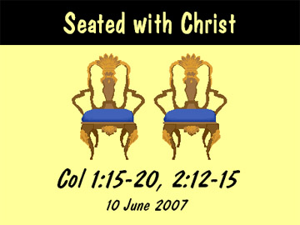
Seated with Christ

